Slide 1
R B5‐05 - REZERVNA ZAŠTITA MREŽE PRI OBNOVLJIVIM IZVORIMA: ZONA 3, PREKOSTRUJNA ZAŠTITA I DRUGE MOGUĆNOSTI
VII savetovanje CG KO CIGRE, 2021.

Slide 2
Introduction
VII SAVETOVANJE O ELEKTROPRENOSNIM MREŽAMA CG KO CIGRE Hotel Mediteran, Bečići, 28 / 09 – 30 / 09/ 2021
Typical Single Line Diagram of Renewable Plant

Slide 3
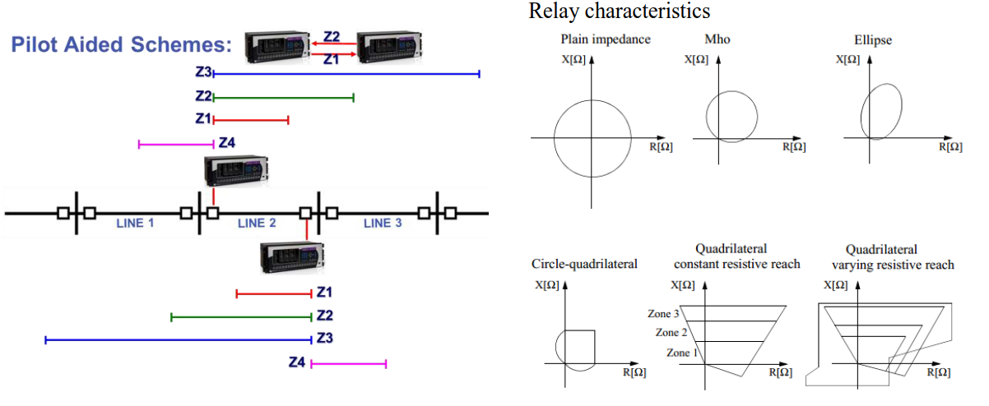
Grid Backup Protection Through Zone 3
VII SAVETOVANJE O ELEKTROPRENOSNIM MREŽAMA CG KO CIGRE Hotel Mediteran, Bečići, 28 / 09 – 30 / 09/ 2021
Stepped distance complemented with pilot aided schemes

Slide 4
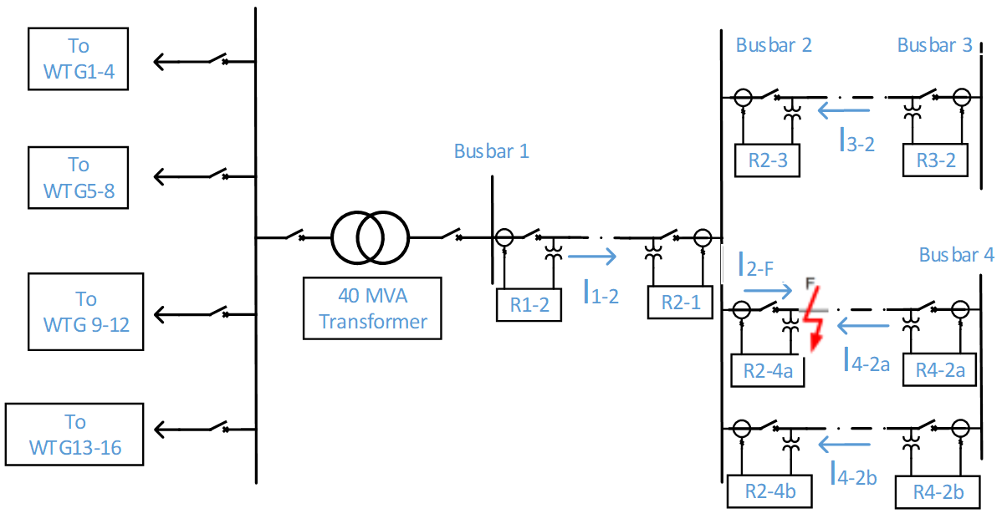
Grid Backup Protection Through Zone 3
VII SAVETOVANJE O ELEKTROPRENOSNIM MREŽAMA CG KO CIGRE Hotel Mediteran, Bečići, 28 / 09 – 30 / 09/ 2021
Zone 3 Minimum Impedance
Zone 3 Maximum Impedance
Current infeed

Slide 5
Grid Backup Protection Through Overcurrent Elements
VII SAVETOVANJE O ELEKTROPRENOSNIM MREŽAMA CG KO CIGRE Hotel Mediteran, Bečići, 28 / 09 – 30 / 09/ 2021
REMOTE REVERSE BLOCKING SCHEME THROUGH ROUTABLE GOOSE

Slide 6
Grid Backup Protection Through Overcurrent Elements
VII SAVETOVANJE O ELEKTROPRENOSNIM MREŽAMA CG KO CIGRE Hotel Mediteran, Bečići, 28 / 09 – 30 / 09/ 2021
REMOTE WEAK INFEED SCHEME THROUGH ROUTABLE GOOSE

Slide 7
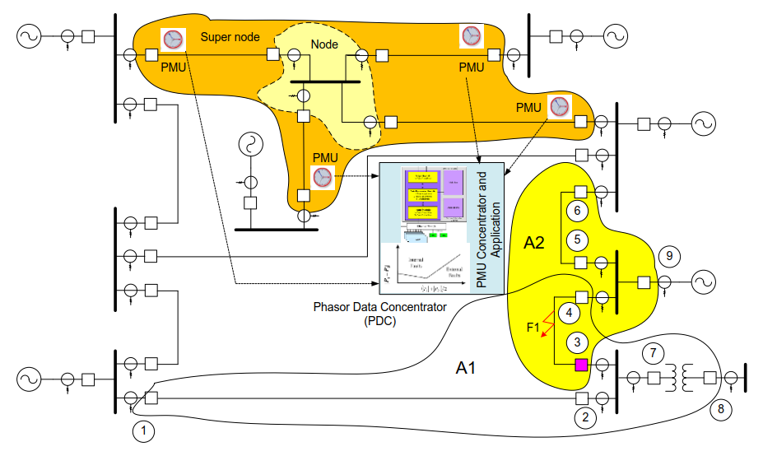
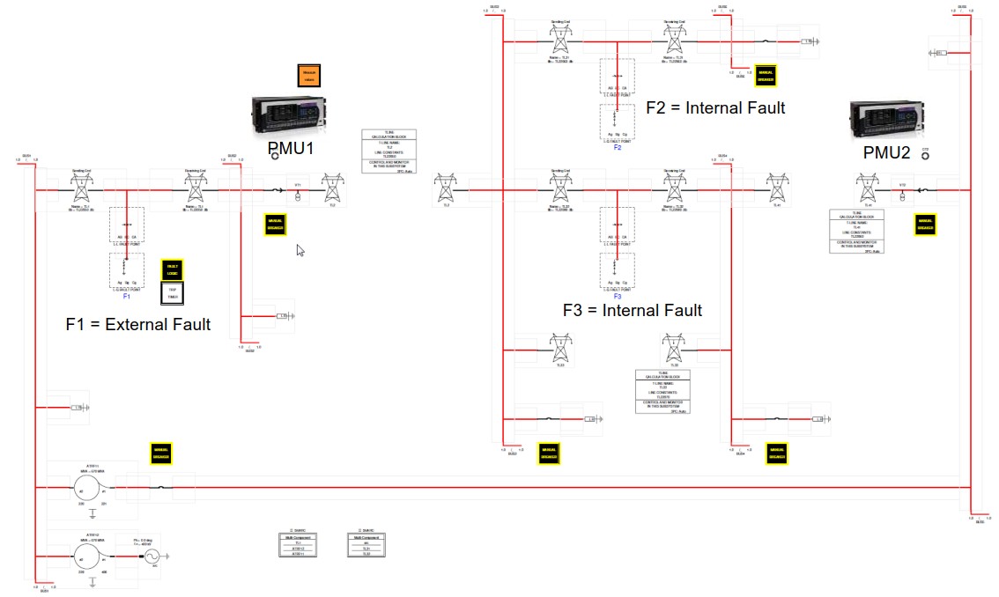
Grid Backup Protection Through PMU
VII SAVETOVANJE O ELEKTROPRENOSNIM MREŽAMA CG KO CIGRE Hotel Mediteran, Bečići, 28 / 09 – 30 / 09/ 2021
Nodes and Super Nodes Overview
RTDS Model for System Under Test

Slide 8
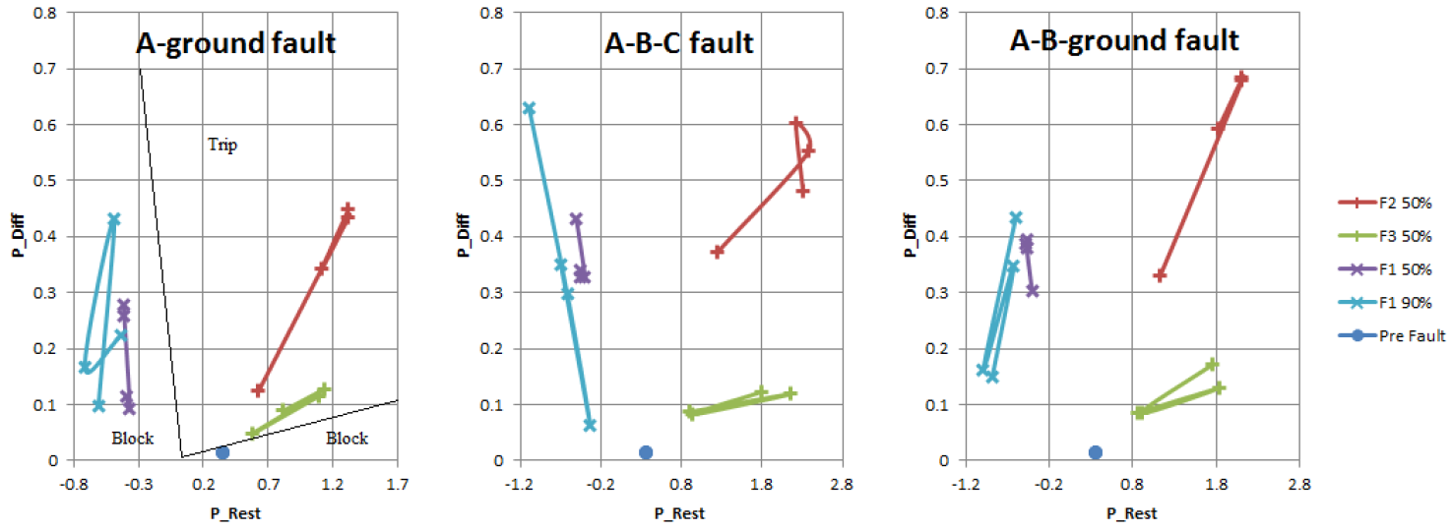
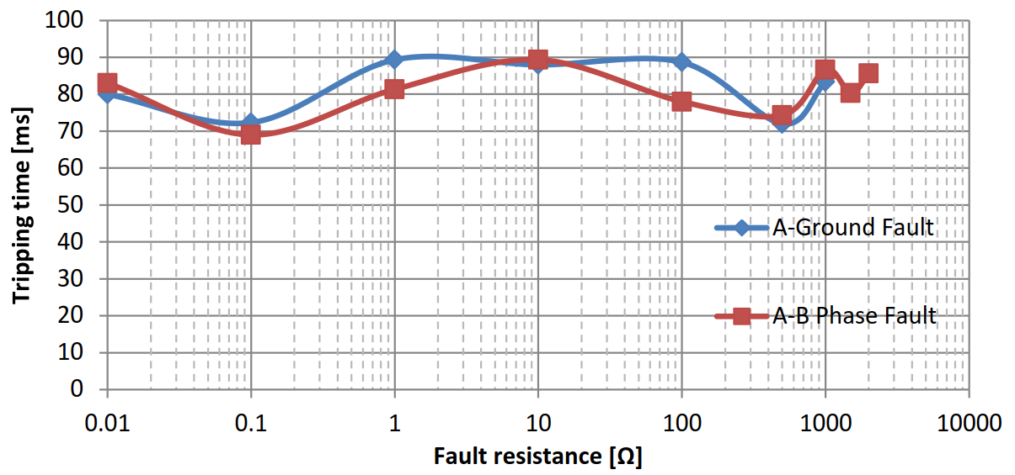
Grid Backup Protection Through PMU
VII SAVETOVANJE O ELEKTROPRENOSNIM MREŽAMA CG KO CIGRE Hotel Mediteran, Bečići, 28 / 09 – 30 / 09/ 2021
RESPONSE WITH DIFFERENTIAL ALGORITHM ASSOCIATED WITH DIRECTIONAL CRITERIA
TRIPPING TIME OF PMU BACKUP PROTECTION

Slide 9
Zaključak / Conclusion
VII SAVETOVANJE O ELEKTROPRENOSNIM MREŽAMA CG KO CIGRE Hotel Mediteran, Bečići, 28 / 09 – 30 / 09/ 2021
Zone 3 is standard practice, but this philosophy presents limitations as it works only with local information.
Zone 3 have been involved on cascading effect on several blackouts due undesired operations during line overloads.
Remote Teleprotection schemes can be implemented through Routable GOOSE with low latency requirements due to long delays for remote backup protection. Special care must be taken due to possible directional improper maloperations due to negative sequence removal on inverters during faults.
Power Differential Algorithm combined with power directional criteria through PMU gives a very good response and correct fault discrimination for all type of faults.
Tests were made using only two PMU´s sending information at 50 values per second with minimum operating times much smaller than typical delay for Zone 3.
Phasor Measurement Unit (PMU) technology provides phasor information (both magnitude and phase angle) in real time. The advantage of referring phase angle to a global reference time is helpful in capturing the wide area snapshot of the power system. Effective utilization of this technology is very useful in mitigating blackouts and learning the real time behavior of the power system.

Slide 10
HVALA NA PAŽNJI! THANK YOU FOR YOUR ATTENTION!

